Slide 1
Project Proposal: E-Waste Classifier
Vladislav Stoimenov
235030

Slide 2
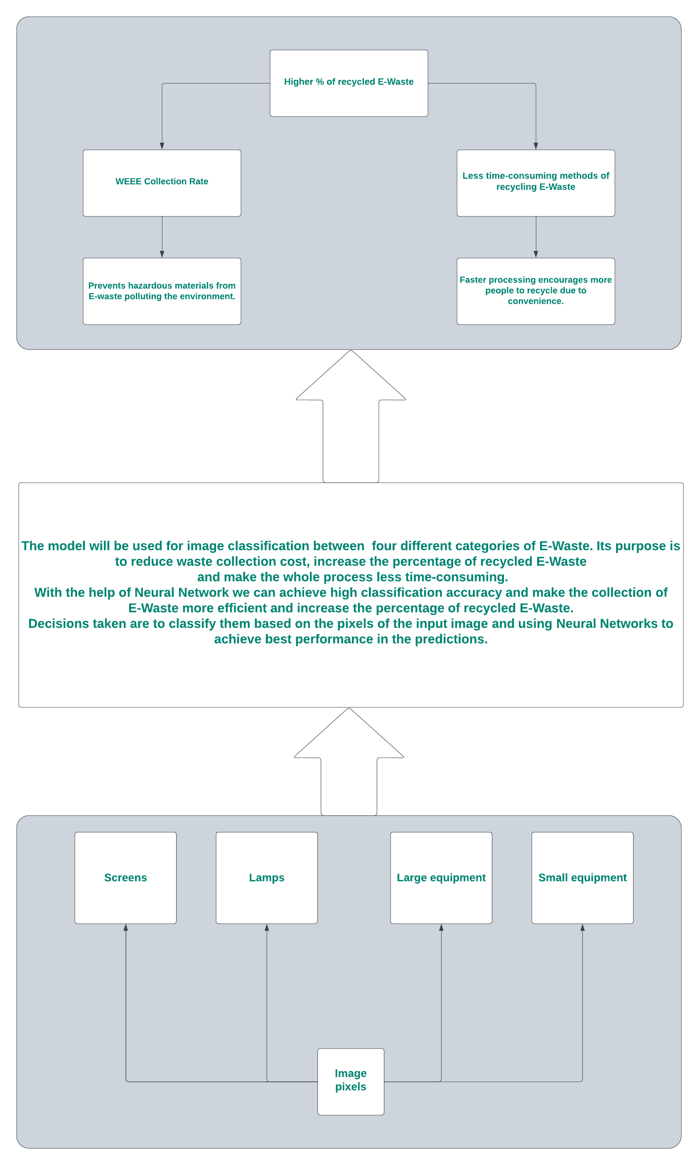
Project Pitch
Business Understanding
The main problem - E-waste poses environmental hazards due to improper disposal and recycling methods.
Main stakeholder – Collecting, Sorting and Recycling Waste from Electrical and Electronic Equipment (WEEE) Companies
The DAPS diagram
The main idea is to create E-Waste Classification App to assist recyclers
Notes:
2 minutes

Slide 3
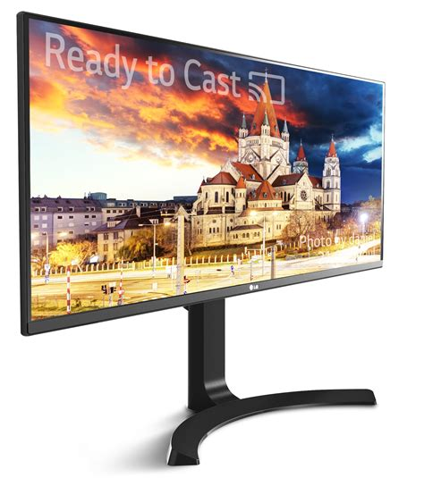
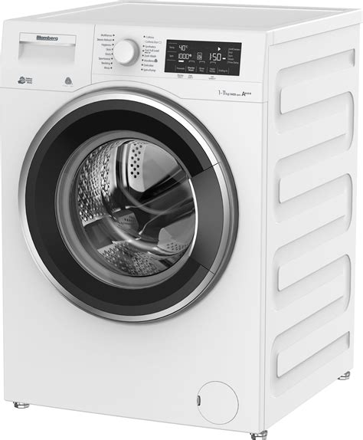
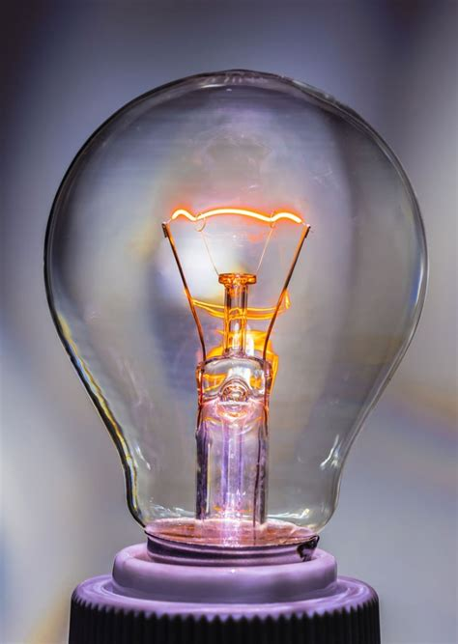
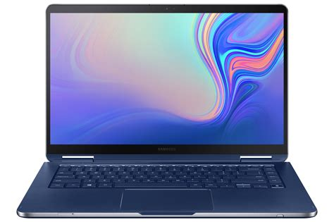
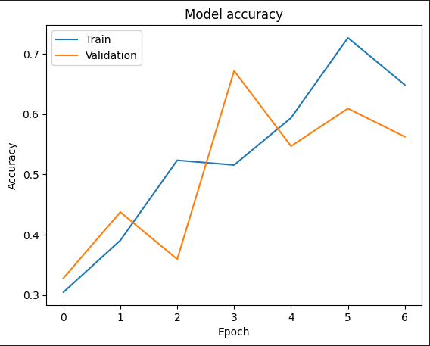
Problem Overview
Deep Learning
Small equipment
Bulbs
Different types of E-Waste (Large equipment, Small Equipment, Light Bulbs, Screens)
4 classes with 100 images each
Random Guess Accuracy – 25%
Human-Level Performance Accuracy – 68.8%
Basic MLP Accuracy ~ 60%
Screens
Large equipment
Basic MLP Accuracy

Slide 4
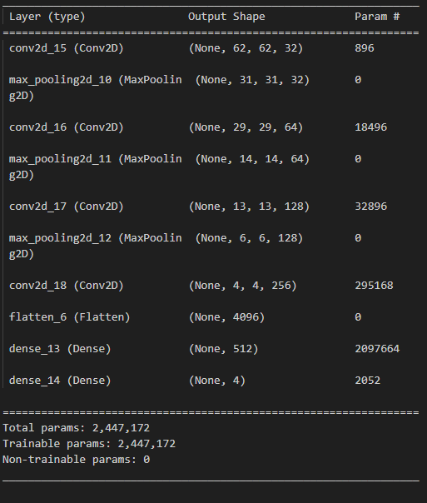
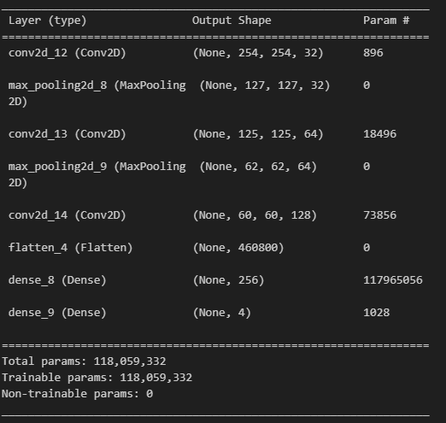
Model Overview
CNN Architecture for Data Augmentation
Deep Learning
4 Iterations
Basic Preprocessing
Data Augmentation
Transfer Learning
Data Augmentation and Transfer Learning
Time Limit: 2 minutes
CNN Architecture for Basic Preprocessing

Slide 5
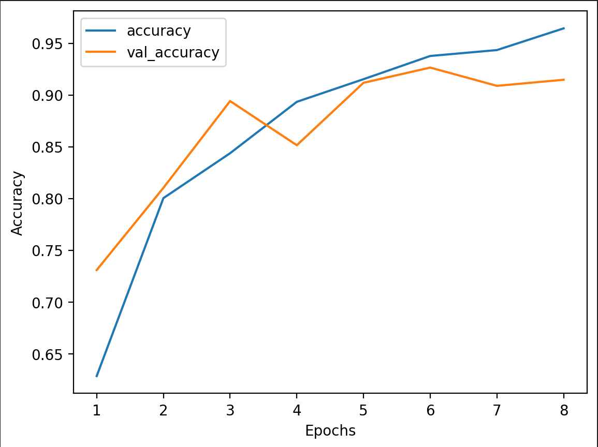
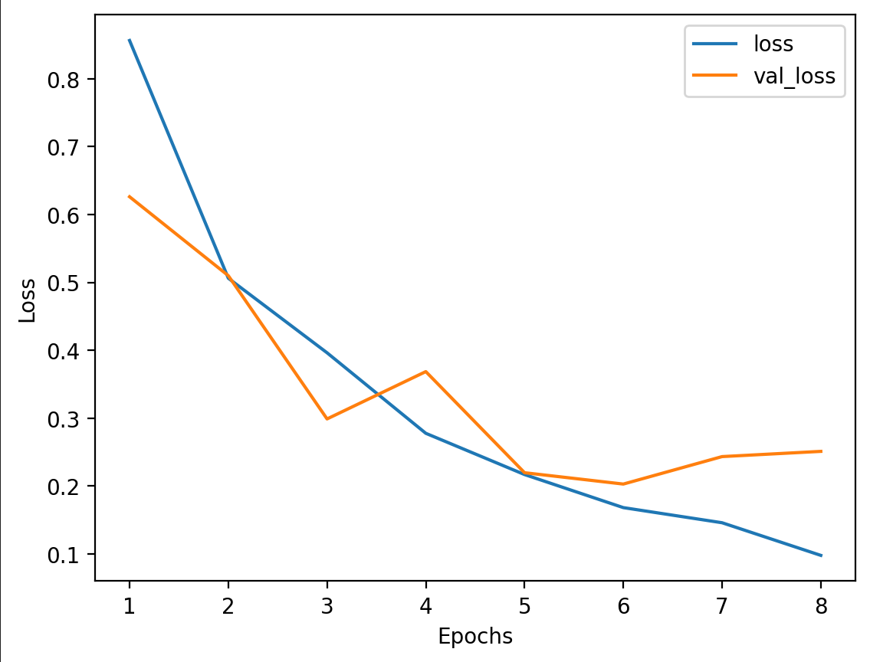
Model Performance
Deep Learning
Performance of the model:
Basic Preprocessing - accuracy of around 65%
Data Augmentation - accuracy of approximately 90%
Transfer Learning – highest accuracy 100%
Transfer Learning and Data Augmentation – decreased the accuracy to around 83%
Time Limit: 1 minute
Accuracy plot of Data Augmentation Iteration
Loss plot of Data Augmentation

Slide 6
User Study
Human-Centered AI
Results of my think-aloud study or your A/B test.
From the A/B test I got that the difference between A and B for all questions is not significant so the changes don't have a real measureable effect
Hypothesis - Version A got a higher average results than version B
t-test
Time Limit: 1 minute
Notes:
I didn’t achieve better user engagement

Slide 7
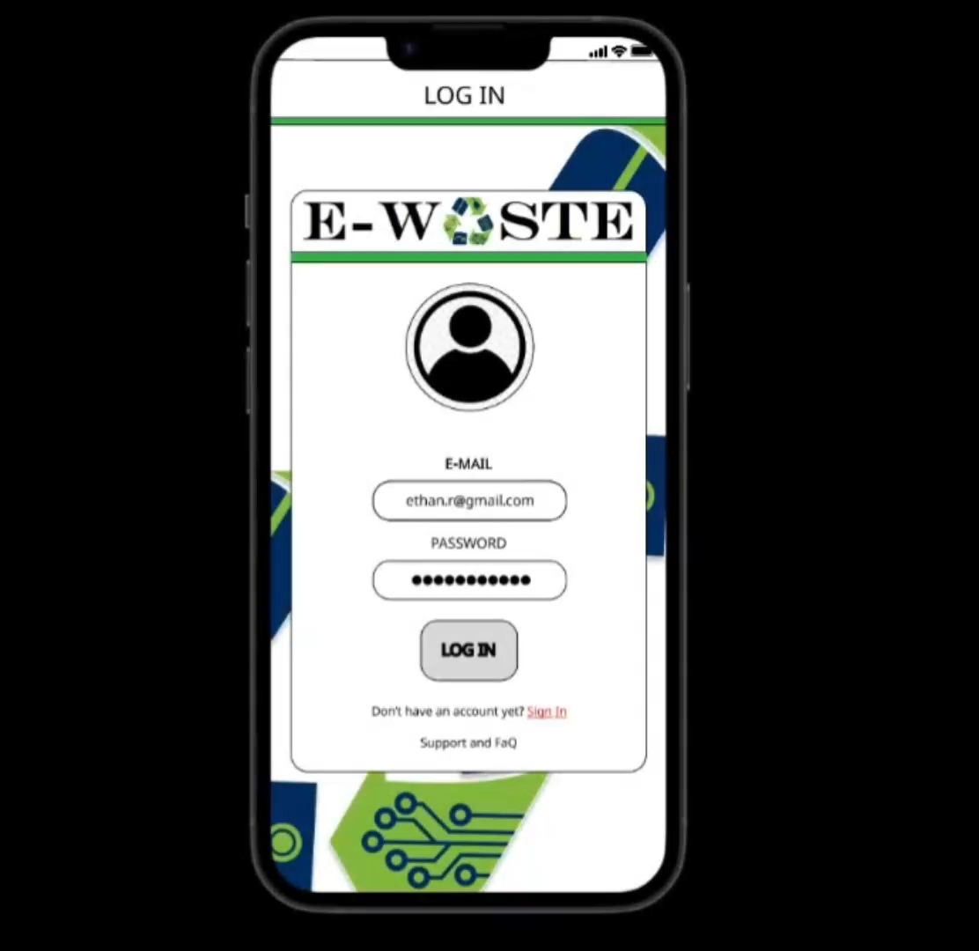
Demo
Human-Centered AI
Final demo video
Time Limit: 2 minute

Slide 8
Thank you!
Any questions?

